Slide 1

Home Depot Product Search Relevance
Jinwei Kang

Slide 2
Project Overview
Success is walking from failure to failure.
1
2
3
4
5
Introduction
Data
Text Pre-Processing
Feautres
Predictive Model
.

Slide 3
Introduction
Home Depot want to improve their customers' shopping experience by developing a model that can accurately predict the relevance of search results.
Search relevancy is an implicit measure Home Depot uses to gauge how quickly they can get customers to the right products.

Slide 4
Data Overview
train.csv - the training set, contains products, searches, and relevance scores
product_descriptions.csv - contains a text description of each product
attributes.csv - provides extended information about a subset of the products

Slide 5
Text Pre-Processing
Spell Checking: correct the spelling of the search terms
Column of Brands: created the name of the brands column
General Processing: Splitting words, lowercase, removing special characters, removing text between parentheses/brackets, replacing word numbers to numerical expression, and standardize the unit's representations
Removing Tags: Removing HTML tags

Slide 6
Text Pre-Processing
Removing Accented Characters: Converted and standardized into ASCII characters.
Tokenization: Tokenizing or splitting a string, text into a list of tokens.
Stemming: Converted to base form of words as root stem
Lemmatization: Converted to base form of words as root word
Removing Stop Word: Words like a, an, the, and so on are considered to be stop words

Slide 7
Text Pre-Processing
Removing Accented Characters: Converted and standardized into ASCII characters.
Tokenization: Tokenizing or splitting a string, text into a list of tokens.
Stemming: Converted to base form of words as root stem
Lemmatization: Converted to base form of words as root word
Removing Stop Word: Words like a, an, the, and so on are considered to be stop words

Slide 8
Tf-idf Common Feature
Length of Words
customers search terms
title of the products
a combination of brands, descriptions, and attributes of products
products ID.
length of the search terms
length of the brands
length of the attributes
Search Terms Matching
number of words that search terms match the product titles
number of words that search terms match the product descriptions
number of words that search terms that match the product attributes
number of words that search terms that match the brands
the first word of the search terms match product titles
the first word of the search terms match the product descriptions
the last word of the search terms match the product titles
the last word of the search terms match the product descriptions.
Word Ratio
the ratio of the number of matching words in the brands and search terms
the ratio of the number of matching words in the product titles and search terms
the ratio of the number of matching words in the product descriptions and search terms
the ratio of the number of matching words in the product attributes and search terms
Features
A total of 34 features
LOGO

Slide 9
Jaccard Distance
Word2Vec, Doc2Vec, FastText
the Jaccard distance between product titles and search terms
the Jaccard distance between product descriptions and search terms
the Jaccard distance between product attributes and search terms
the cosine distance between product titles and search terms based on a Word2Vec, Doc2Vec, and FastText model
the cosine distance between product descriptions and search terms based on a Word2Vec, Doc2Vec, and FastText model
the cosine distance between product attributes and search terms based on a Word2Vec, Doc2Vec, and FastText model
Levenshtein Distance
the Levenshtein distance between product titles and search terms
the Levenshtein distance between product descriptions and search terms
the Levenshtein distance between product attributes and search terms
Features
A total of 34 features

Slide 10
Predictive Model
LightGBM performed the best with RMSE 0.4530
Bagging performed the sceond best with RMSE 0.4744
Algorithms | RMSE
Lasso | 0.5251
Elastic Net | 0.5250
Ridge Regression | 0.4659
SVR | 0.5529
Bagging | 0.4744
Random Forest | 0.4761
AdaBoost | 0.4794
Gradient Boost | 0.4794
XGBoost | 0.4576
LightGBM | 0.4530
Voting Regression | 0.4576

Slide 11
Hyperparameter Tuning
Random Forest:
After hyperparmeter tuning, LightGBM performed the best with RMSE 0.4530
After hyperparmeter tuning, random forest performed the best with RMSE 0.4552
Parameter | Value
bootstrap | False
max_depth | 11
max_features | sqrt
min_samples_leaf | 1
min_samples_split | 2
n_estimators | 1600
LightGBM:
Parameter | Value
learning_rate | 0.05
max_bin | 64
max_depth | 15
min_data_in_leaf | 40
num_leaves | 200

Slide 12
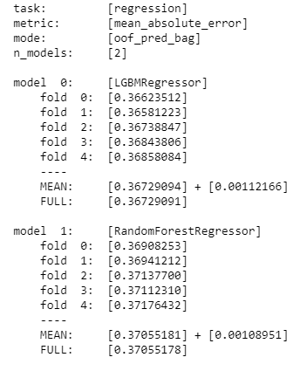
Final Model
After stacking random forest and lightGBM models, the final model with lightGBM performed the best with RMSE 0.4521
Private score：0.46185 on Kaggle
Ranked #134 among 2124 participants

Slide 13
THANK YOU

